Slide 1
Chapter 3 – Agile Software Development
Some of the slides taken from:
Adam Warner’s presentation during NCES MIS Conference - February 15, 2012 - San Diego
https://nces.ed.gov/whatsnew/conferences/MIS/2012/ppt/V_G_Warner.pptx

Slide 2
Topics covered
Agile methods
Agile development techniques
Agile project management
Exercise: Select suitable Agile project management tool

Slide 3
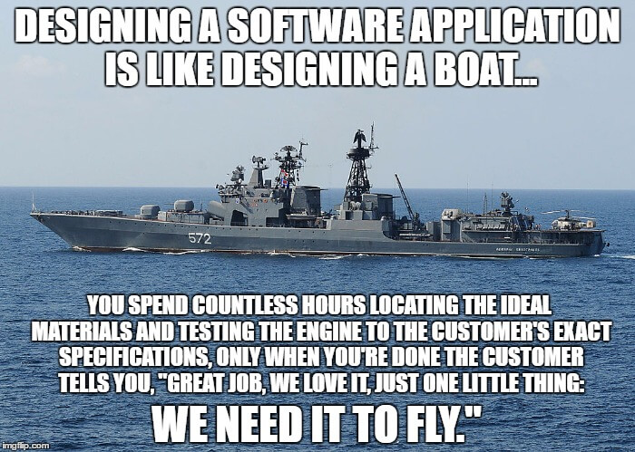
https://exceptionnotfound.net/useful-software-development-analogies-meme-version/

Slide 4

The Problem(s) with Software Development
Customers do not know exactly what they need or want
Customers change their minds
Customers’ priorities change
It is difficult to solve the needs of many stakeholders
We can never adequately specify requirements
We are lousy at estimating software tasks
Unpredictable “stuff” happens
It often takes several times to get “something” right
Users do not know what they want until they see it (but are good at telling us what they do not like)
It is difficult to determine the 80:20; that is, what features are most important - before the product is built and deployed
It is difficult to account for the unknown

Slide 5
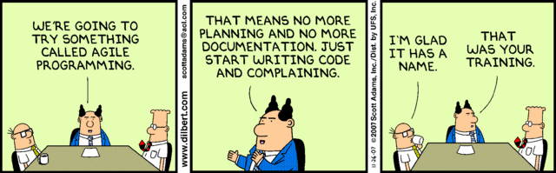

Slide 6
What to do? “Agile” is born
Agile Manifesto
We are uncovering better ways of developing software by doing it and helping others do it. Through this work we have come to value:
Individuals and interactions over processes and tools
Working software over comprehensive documentation
Customer collaboration over contract negotiation
Responding to change over following a plan
That is, while there is value in the items on the right, we value the items on the left more.
http://agilemanifesto.org/

Slide 7
Principles behind the Manifesto
Our highest priority is to satisfy the customer through early and continuous delivery of valuable software.
Welcome changing requirements, even late in development. Agile processes harness change for the customer's competitive advantage.
Deliver working software frequently, from a couple of weeks to a couple of months, with a preference to the shorter timescale.
Business people and developers must work together daily throughout the project.
Build projects around motivated individuals. Give them the environment and support they need, and trust them to get the job done.
The most efficient and effective method of conveying information to and within a development team is face-to-face conversation.

Slide 8
Principles behind the Manifesto
Working software is the primary measure of progress.
Agile processes promote sustainable development. The sponsors, developers, and users should be able to maintain a constant pace indefinitely.
Continuous attention to technical excellence and good design enhances agility.
Simplicity--the art of maximizing the amount of work not done--is essential.
The best architectures, requirements, and designs emerge from self-organizing teams.
At regular intervals, the team reflects on how to become more effective, then tunes and adjusts its behavior accordingly.
Source: http://agilemanifesto.org/principles.html

Slide 9
Key Aspects of Agile Methodology
Agile Methodologies
Iterative
Incremental
Self-Organizing
Planned modification of parts of the system. Assists with modification of design and requirements
Develop parts of the system separately and integrate. Assists with improving overall methodology
The team has the responsibility of organizing its internal dynamics.
Emergent
The set of tools, techniques, development environment, and requirements emerge in the process

Slide 10
The principles of agile methods
Principle | Description
Customer involvement | Customers should be closely involved throughout the development process. Their role is provide and prioritize new system requirements and to evaluate the iterations of the system.
Incremental delivery | The software is developed in increments with the customer specifying the requirements to be included in each increment.
People not process | The skills of the development team should be recognized and exploited. Team members should be left to develop their own ways of working without prescriptive processes.
Embrace change | Expect the system requirements to change and so design the system to accommodate these changes.
Maintain simplicity | Focus on simplicity in both the software being developed and in the development process. Wherever possible, actively work to eliminate complexity from the system.

Slide 11
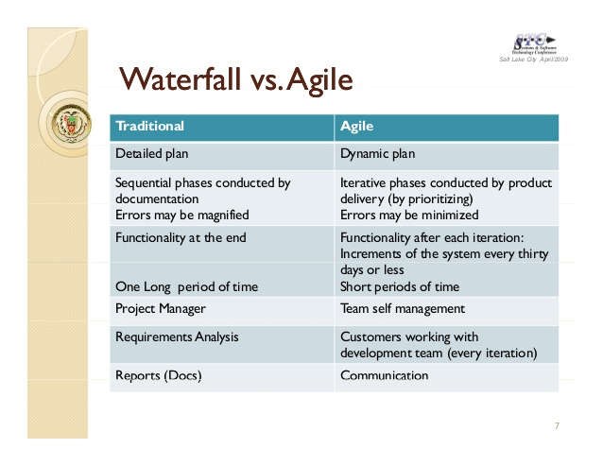

Slide 12
Agile Implementations
Extreme Programming
Scrum
Iterative development
Kanban
And many others

Slide 13
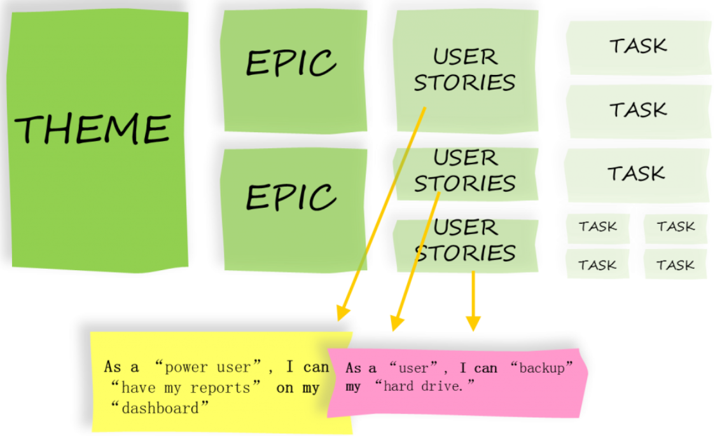
Theme, Epic, Story, Task

Slide 14
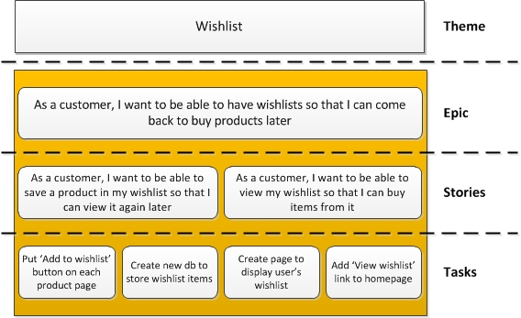
Theme, Epic, Story, Task

Slide 15
Stories – aka Product Backlog Item, Work Item
A story is an individual feature or requirement that the client (and business) wants. It is something that is deliverable (i.e. production ready) within a single sprint.
Stories are often written in a specific format:
As a [end user of the required feature]
I want [actual thing the user wants to be able to do once the feature is live – so often contains a verb]
So that [why they want this feature / the benefit this feature brings]
An example story: “As a customer, I want to be able to save a product in my wishlist so that I can view it again later.”

Slide 16
User Stories
A set of stories that describe how the system should behave, from the user’s viewpoint.
There may be several different types of user; for instance, browser, shopper, marketer, content editor, systems administrator, etc., and we can write stories for all of them.
This is usually done collaboratively, with a bunch of people writing out cards, grouping them together and reviewing.
After a short period we should have a broad idea of what our system should do, encapsulated in a set of user stories, which we call the Product Backlog.

Slide 17
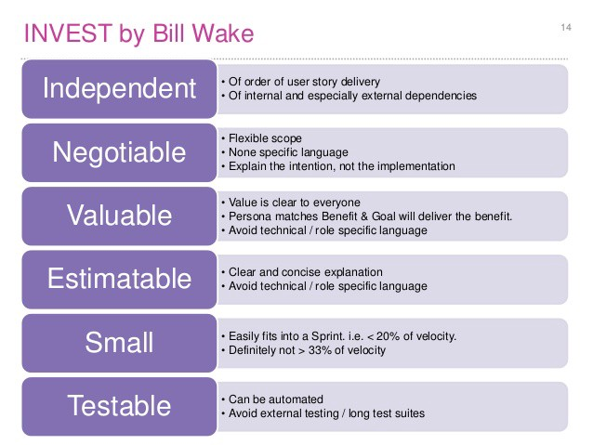
Key Aspects of User Stories

Slide 18
Story Walls
A story wall is a very common and effective information radiator that displays the status of each card in the current iteration or sprint.
Typically, a story wall contains columns that represent a team’s workflow, index cards representing the actual work, user stories and other metadata to communicate the status of a project.
The team moves a card through each column as it gets completed.

Slide 19
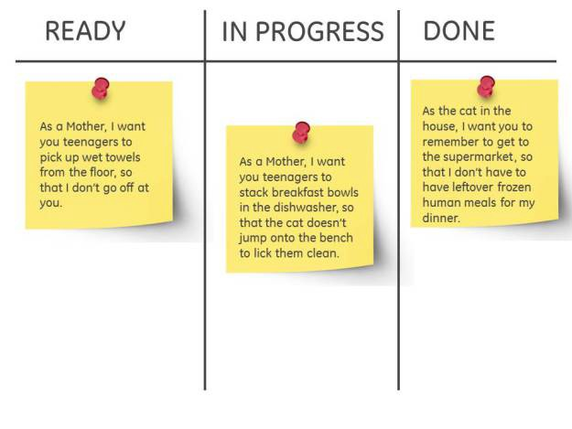
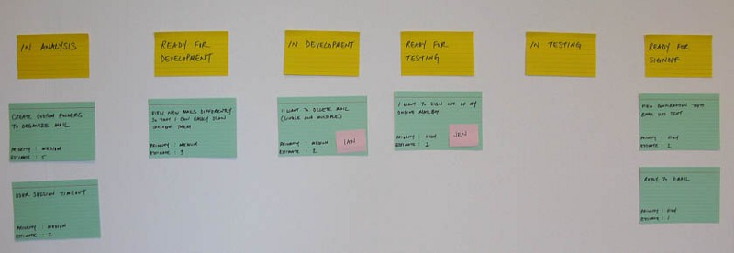
Story Walls

Slide 20

Epic
An epic is a big story. A requirement that is just too big to deliver in a single sprint.
Epics need to be broken into smaller deliverables (stories).
An example epic: “As a customer, I want to be able to have wishlists so that I can come back to buy products later.”

Slide 21
Theme
A collection of stories by category. A basket or bucket of stories. By its nature, an epic can also be a theme in itself.
An example theme: “Wishlist”.

Slide 22
Tasks
The elements of a story.
Stepping stones to take the story to ‘Done’.
Tasks often follow the SMART acronym: specific, measurable, achievable, relevant, time-boxed.
An example task: “Put ‘Add to wishlist’ button on each product page.”

Slide 23
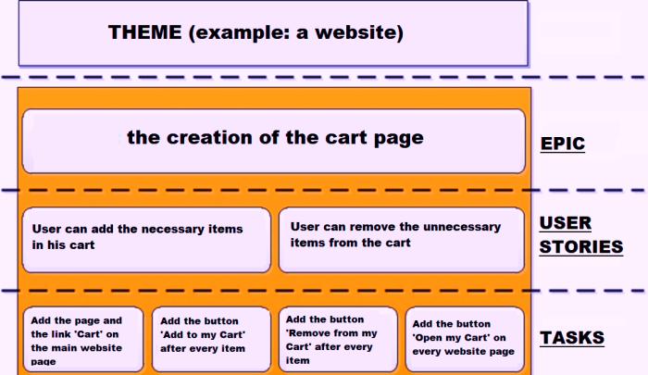
Theme, Epic, User Stories, Tasks

Slide 24
Extreme programming
A very influential agile method, developed in the late 1990s, that introduced a range of agile development techniques.
Extreme Programming (XP) takes an ‘extreme’ approach to iterative development.
New versions may be built several times per day;
Increments are delivered to customers every 2 weeks;
All tests must be run for every build and the build is only accepted if tests run successfully.

Slide 25
The extreme programming release cycle

Slide 26
Extreme programming practices (a)
Principle or practice | Description
Incremental planning | Requirements are recorded on story cards and the stories to be included in a release are determined by the time available and their relative priority. The developers break these stories into development ‘Tasks’. See Figures 3.5 and 3.6.
Small releases | The minimal useful set of functionality that provides business value is developed first. Releases of the system are frequent and incrementally add functionality to the first release.
Simple design | Enough design is carried out to meet the current requirements and no more.
Test-first development | An automated unit test framework is used to write tests for a new piece of functionality before that functionality itself is implemented.
Refactoring | All developers are expected to refactor the code continuously as soon as possible code improvements are found. This keeps the code simple and maintainable.

Slide 27
Extreme programming practices (b)
Pair programming | Developers work in pairs, checking each other’s work and providing the support to always do a good job.
Collective ownership | The pairs of developers work on all areas of the system, so that no islands of expertise develop and all the developers take responsibility for all of the code. Anyone can change anything.
Continuous integration | As soon as the work on a task is complete, it is integrated into the whole system. After any such integration, all the unit tests in the system must pass.
Sustainable pace | Large amounts of overtime are not considered acceptable as the net effect is often to reduce code quality and medium term productivity
On-site customer | A representative of the end-user of the system (the customer) should be available full time for the use of the XP team. In an extreme programming process, the customer is a member of the development team and is responsible for bringing system requirements to the team for implementation.

Slide 28
Scrum
Scrum is an agile method that focuses on managing iterative development rather than specific agile practices.
There are three phases in Scrum.
The initial phase is an outline planning phase where you establish the general objectives for the project and design the software architecture.
This is followed by a series of sprint cycles, where each cycle develops an increment of the system.
The project closure phase wraps up the project, completes required documentation such as system help frames and user manuals and assesses the lessons learned from the project.

Slide 29
Scrum terminology (a)
Scrum term | Definition
Development team | A self-organizing group of software developers, which should be no more than 7 people. They are responsible for developing the software and other essential project documents.
Potentially shippable product increment | The software increment that is delivered from a sprint. The idea is that this should be ‘potentially shippable’ which means that it is in a finished state and no further work, such as testing, is needed to incorporate it into the final product. In practice, this is not always achievable.
Product backlog | This is a list of ‘to do’ items which the Scrum team must tackle. They may be feature definitions for the software, software requirements, user stories or descriptions of supplementary tasks that are needed, such as architecture definition or user documentation.
Product owner | An individual (or possibly a small group) whose job is to identify product features or requirements, prioritize these for development and continuously review the product backlog to ensure that the project continues to meet critical business needs. The Product Owner can be a customer but might also be a product manager in a software company or other stakeholder representative.

Slide 30
Scrum terminology (b)
Scrum term | Definition
Scrum | A daily meeting of the Scrum team that reviews progress and prioritizes work to be done that day. Ideally, this should be a short face-to-face meeting that includes the whole team.
ScrumMaster | The ScrumMaster is responsible for ensuring that the Scrum process is followed and guides the team in the effective use of Scrum. He or she is responsible for interfacing with the rest of the company and for ensuring that the Scrum team is not diverted by outside interference. The Scrum developers are adamant that the ScrumMaster should not be thought of as a project manager. Others, however, may not always find it easy to see the difference.
Sprint | A development iteration. Sprints are usually 2-4 weeks long.
Velocity | An estimate of how much product backlog effort that a team can cover in a single sprint. Understanding a team’s velocity helps them estimate what can be covered in a sprint and provides a basis for measuring improving performance.

Slide 31
Scrum sprint cycle

Slide 32
The Scrum sprint cycle
Sprints are fixed length, normally 2–4 weeks.
The starting point for planning is the product backlog, which is the list of work to be done on the project.
The selection phase involves all of the project team who work with the customer to select the features and functionality from the product backlog to be developed during the sprint.

Slide 33
The Sprint cycle
Once these are agreed, the team organize themselves to develop the software.
During this stage the team is isolated from the customer and the organization, with all communications channelled through the so-called ‘Scrum master’.
The role of the Scrum master is to protect the development team from external distractions.
At the end of the sprint, the work done is reviewed and presented to stakeholders. The next sprint cycle then begins.

Slide 34
Teamwork in Scrum
The ‘Scrum master’ is a facilitator who arranges daily meetings, tracks the backlog of work to be done, records decisions, measures progress against the backlog and communicates with customers and management outside of the team.
The whole team attends short daily meetings (Scrums) where all team members share information, describe their progress since the last meeting, problems that have arisen and what is planned for the following day.
This means that everyone on the team knows what is going on and, if problems arise, can re-plan short-term work to cope with them.

Slide 35
Scrum benefits
The product is broken down into a set of manageable and understandable chunks.
Unstable requirements do not hold up progress.
The whole team have visibility of everything and consequently team communication is improved.
Customers see on-time delivery of increments and gain feedback on how the product works.
Trust between customers and developers is established and a positive culture is created in which everyone expects the project to succeed.

Slide 36
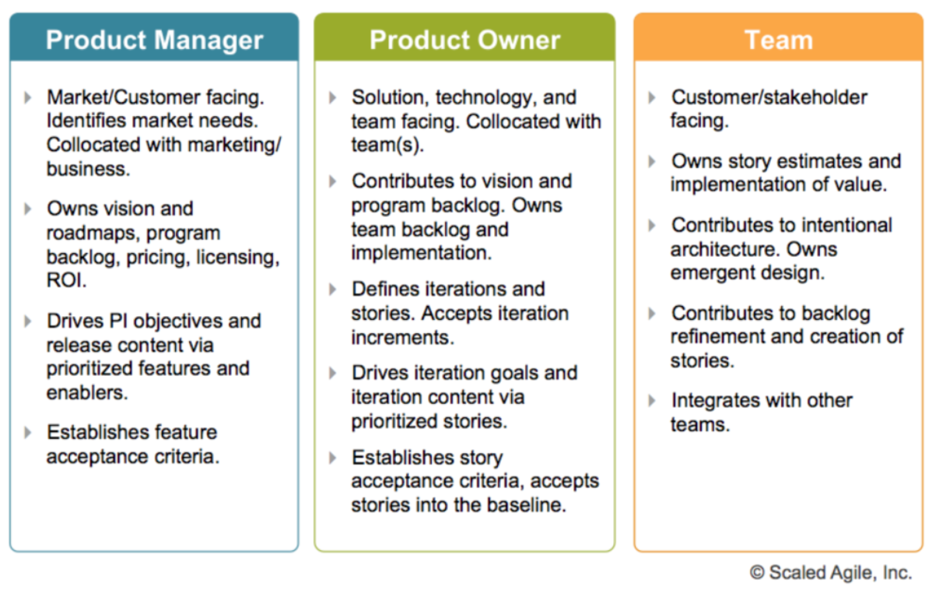
Agile Stakeholders

Slide 37
Distributed Scrum

Slide 38
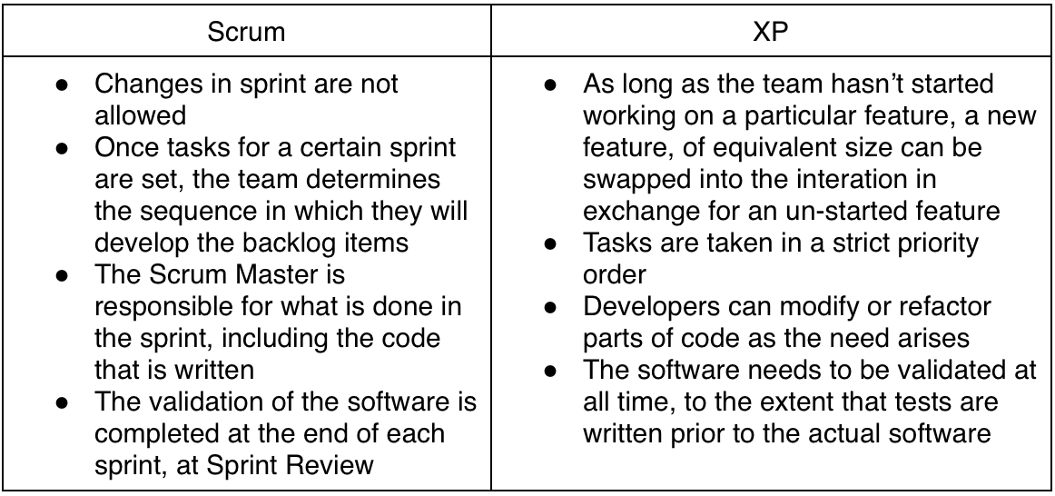
Scrum vs. Extreme Programming

Slide 39
Agile project management
The principal responsibility of software project managers is to manage the project so that the software is delivered on time and within the planned budget for the project.
The standard approach to project management is plan-driven. Managers draw up a plan for the project showing what should be delivered, when it should be delivered and who will work on the development of the project deliverables.
Agile project management requires a different approach, which is adapted to incremental development and the practices used in agile methods.

Slide 40
Exercise
Go through a list of free Agile Project Management tools.
Select a tool of your choice for your project.
https://www.daxx.com/blog/development-team/free-agile-project-management-tools-for-your-scrum

